Slide 1
Ansible pour la gestion centralisée de réseau
David Lefebvre
Ingénieur de systèmes spécialisé en centre de données
Cisco

Slide 2
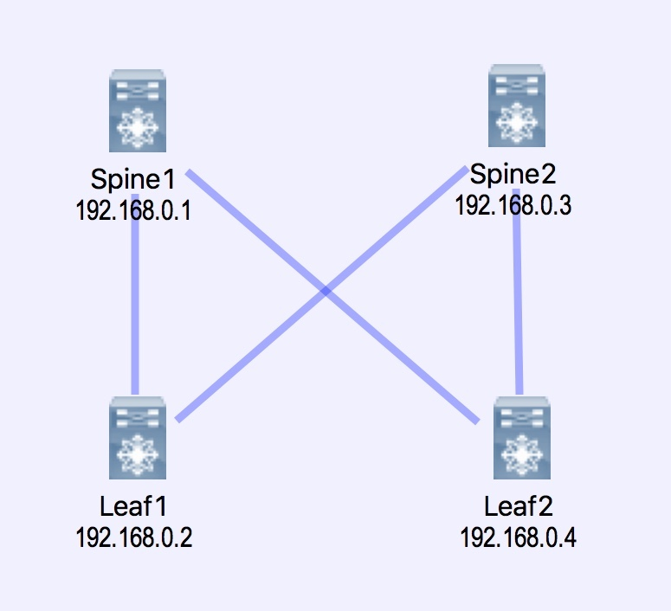
Topologie utilisée
Bâtie avec VIRL
http://virl.cisco.com/
Virtual Internet Routing Lab

Slide 3
Différentes commandes selon le manufacturier
nxos_aaa_server Manages AAA server global configuration.
nxos_aaa_server_host Manages AAA server host-specific configuration.
nxos_acl Manages access list entries for ACLs.
nxos_acl_interface Manages applying ACLs to interfaces.
nxos_bgp Manages BGP configuration.
nxos_bgp_af Manages BGP Address-family configuration.
nxos_bgp_neighbor Manages BGP neighbors configurations.
nxos_bgp_neighbor_af Manages BGP address-family’s neighbors configuration.
nxos_command Run arbitrary command on Cisco NXOS devices
nxos_config Manage Cisco NXOS configuration sections
nxos_evpn_global Handles the EVPN control plane for VXLAN.
nxos_evpn_vni Manages Cisco EVPN VXLAN Network Identifier (VNI).
nxos_facts Gets facts about NX-OS switches
nxos_feature Manage features in NX-OS switches.
nxos_file_copy Copy a file to a remote NXOS device over SCP.
nxos_gir Trigger a graceful removal or insertion (GIR) of the switch.
nxos_gir_profile_management Create a maintenance-mode or normal-mode profile for GIR.
nxos_hsrp Manages HSRP configuration on NX-OS switches.
nxos_igmp Manages IGMP global configuration.
nxos_igmp_interface Manages IGMP interface configuration.
nxos_igmp_snooping Manages IGMP snooping global configuration.
nxos_install_os Set boot options like boot image and kickstart image.
nxos_interface Manages physical attributes of interfaces.
nxos_interface_ospf Manages configuration of an OSPF interface instance.
nxos_ip_interface Manages L3 attributes for IPv4 and IPv6 interfaces.
nxos_mtu Manages MTU settings on Nexus switch.
nxos_ntp Manages core NTP configuration.
nxos_ntp_auth Manages NTP authentication.
nxos_ntp_options Manages NTP options.
nxos_nxapi Manage NXAPI configuration on an NXOS device.
nxos_ospf Manages configuration of an ospf instance.
nxos_ospf_vrf Manages a VRF for an OSPF router.
nxos_overlay_global Configures anycast gateway MAC of the switch.
nxos_pim Manages configuration of a PIM instance.
nxos_pim_interface Manages PIM interface configuration.
nxos_pim_rp_address Manages configuration of an PIM static RP address instance.
nxos_ping Tests reachability using ping from Nexus switch.
nxos_portchannel Manages port-channel interfaces.
nxos_reboot Reboot a network device.
nxos_rollback Set a checkpoint or rollback to a checkpoint.
nxos_smu Perform SMUs on Cisco NX-OS devices.
nxos_snapshot Manage snapshots of the running states of selected features.
nxos_snmp_community Manages SNMP community configs.
nxos_snmp_contact Manages SNMP contact info.
nxos_snmp_host Manages SNMP host configuration.
nxos_snmp_location Manages SNMP location information.
nxos_snmp_traps Manages SNMP traps.
nxos_snmp_user Manages SNMP users for monitoring.
nxos_static_route Manages static route configuration
nxos_switchport Manages Layer 2 switchport interfaces.
nxos_system Manage the system attributes on Cisco NXOS devices
nxos_template Manage Cisco NXOS device configurations
nxos_udld Manages UDLD global configuration params.
nxos_udld_interface Manages UDLD interface configuration params.
nxos_user Manage the collection of local users on Nexus devices
nxos_vlan Manages VLAN resources and attributes.
nxos_vpc Manages global VPC configuration
nxos_vpc_interface Manages interface VPC configuration
nxos_vrf Manages global VRF configuration.
nxos_vrf_af Manages VRF AF.
nxos_vrf_interface Manages interface specific VRF configuration.
nxos_vrrp Manages VRRP configuration on NX-OS switches.
nxos_vtp_domain Manages VTP domain configuration.
nxos_vtp_password Manages VTP password configuration.
nxos_vtp_version Manages VTP version configuration.
nxos_vxlan_vtep Manages VXLAN Network Virtualization Endpoint (NVE).
nxos_vxlan_vtep_vni Creates a Virtual Network Identifier member (VNI)
eos_banner Manage multiline banners on Arista EOS devices
eos_command Run arbitrary commands on an Arista EOS device
eos_config Manage Arista EOS configuration sections
eos_eapi Manage and configure Arista EOS eAPI.
eos_facts Collect facts from remote devices running Arista EOS
eos_system Manage the system attributes on Arista EOS devices
eos_template Manage Arista EOS device configurations
eos_user Manage the collection of local users on EOS devices
junos_command Run arbitrary commands on an Juniper JUNOS device
junos_config Manage configuration on devices running Juniper JUNOS
junos_facts Collect facts from remote devices running Junos
junos_netconf Configures the Junos Netconf system service
junos_package Installs packages on remote devices running Junos
junos_rpc Runs an arbitrary RPC on the remote device over NetConf
junos_template Manage configuration on remote devices running Junos
junos_user Manage local user accounts on Juniper devices

Slide 4
Où commencer
Cisco offre un site dédié aux développeurs :
https://developer.cisco.com/site/devnet/home/index.gsp
Page spécifique pour l’automatisation du réseau avec Ansible :
https://developer.cisco.com/site/nx-os/docs/automation/ansible/
Modules disponibles sur le site d’Ansible :
https://docs.ansible.com/ansible/list_of_network_modules.html

